Slide 1
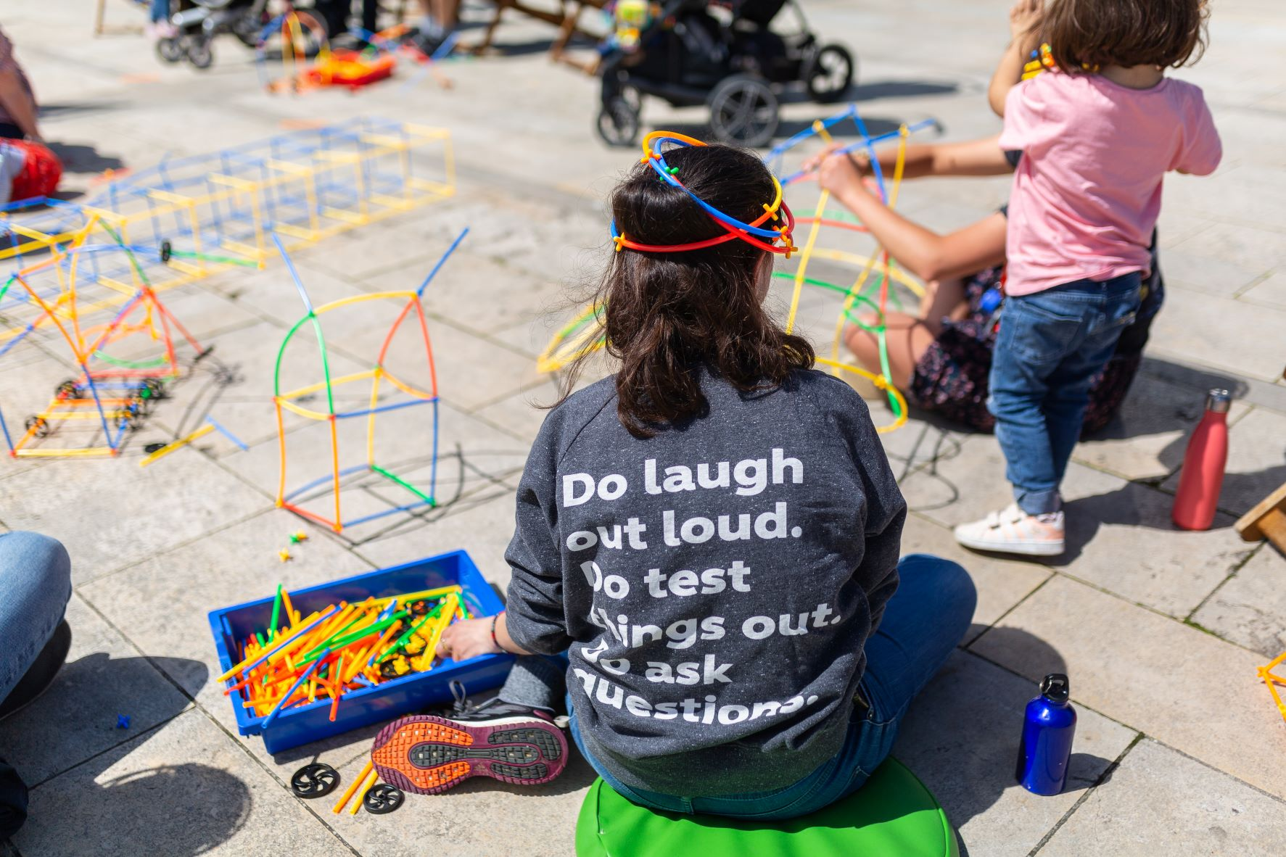
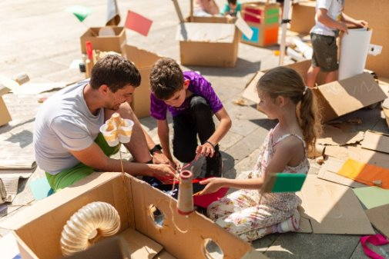
we the curious
Community Programme
Photo credit: Lisa Whiting
About Us
We The Curious is an award-winning educational charity and science centre based in the heart of Bristol’s harbourside, and the largest provider of STEM education outside the classroom in the Southwest. In a typical year we support 300,000 visitors and 75,000 school children. ​
Our aim is to make science inclusive for all, to build science capital and to make cutting-edge science relevant, accessible, and empowering. We do this through our curriculum-enhancing schools’ program, interactive exhibits, environmental sustainability initiatives, volunteering, and outreach programs. ​
After years of disruption due to the pandemic and the current cost of living crisis we have seen how those least represented with STEM have been disproportionately impacted. Now more than ever, we are determined to overcome this disparity in educational attainment and engagement in STEM.
For example, in Bristol, there's a stark contrast in further education access, with 100% in affluent areas versus 8% in the most disadvantaged ward. 41 areas are in the most deprived 10% in England, including three in the bottom 1% in South Bristol (Bristol Council Key Facts 2023). Addressing these disparities is crucial. Research shows Bristol is currently ranked seventh worst of 348 districts in England & Wales for the multiple inequalities: Research & Reports - Babbasa
Background
Our Community Programme will play a vital role in our inclusion strategy creating improved access and pathways to engagement for our priority audiences - young people, disabled people, people experiencing racism and communities experiencing social inequality. It aims to overcome the perception that ‘STEM is not for everyone’ and meet the needs of communities, addressing the inequalities which exist in Bristol and the wider community.
The programme builds upon our work during closure where our teams delivered a community consultation and adapted our inclusion programmes to operate in community spaces. We delivered activities with school partners in disadvantaged wards (5,193 children) and community groups (27,899 engagements at 176 events).
This has provided valuable insights into how we can support them with their own goals and how we can better engage people experiencing social inequity in our mission to connect and empower people through STEM (science, technology, engineering and maths).
wethecurious

Slide 2
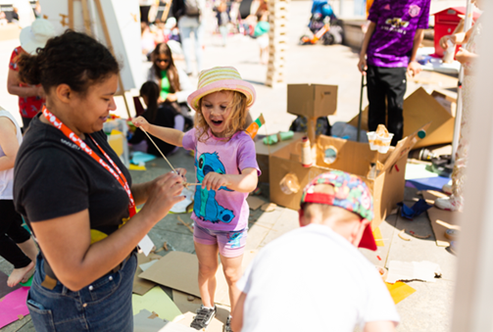
Community Programme Case for Support
First Steps
In response to feedback to make STEM learning opportunities at WTC more accessible and to better address the structural inequalities prevalent in Bristol and the wider community, we have responded by making our spaces more welcoming.
We have introduced quiet/sensory rooms, multi-faith spaces and accessibility adaptions. We have also addressed financial exclusion by committing to inclusive ticket concessions (free community group membership for eligible charities and not for profit organisations, free tickets for refugees and asylum seekers and a 50% concession on entry for schools with over 22% free school meals).
However, we know that this work doesn’t go far enough. Improving facilities and making entry free or affordable doesn’t necessarily lead to greater diversity in our visitors, engagement and participation in STEM and doesn’t always address the specific needs of communities and individuals.
Community Programme Overview
Our Community Programme responds directly to feedback from diverse communities and places their needs at the heart of shaping our approach to enhancing access to our venue, resources, expertise and partnerships. We will deliver:
Free hands-on science activities and projects conducted out in communities. This will include free Out and About activities within communities that experience social inequity, the relaunch Curiosity Club (a regular meetup for adults with disabilities), and activity days with young people at risk of exclusion from mainstream education.
A new Community Membership Leaders’ Network and special events for community leaders to shape how WTC utilises its resources, venue, expertise and partnerships to meet their community's needs and overcome the barriers they encounter in accessing inclusive science learning opportunities offered by We the Curious.
Improved access and communication about opportunities at WTC. We will be proactively approaching and connecting with communities as a first step towards breaking down barriers and opening up new and existing pathways to participation.
To achieve these goals, we will increase our staff capacity and inclusion expertise.
More information about specific goals and programme delivery are available on request.
Funding and Timeline:
Our Community Programme will cost £165,715 to run until March 2026 (full budget breakdown available on request). We have already had a generous donation of £40,000 from the Nisbet Trust and We the Curious will invest funds towards the Programme Development, Delivery, Marketing, Coms, Filming and Evaluation but we still urgently need to raise the remainder.
Development work is currently being undertaken with the main Programme launching over Summer/Autumn 2024 (more detail is available on request).
For more information:
Email: development@wethecurious.org
or call us on 0117 915 1000
wethecurious

